Slide 1
Control Engineering
Lecture 14
MIMO systems

Slide 2
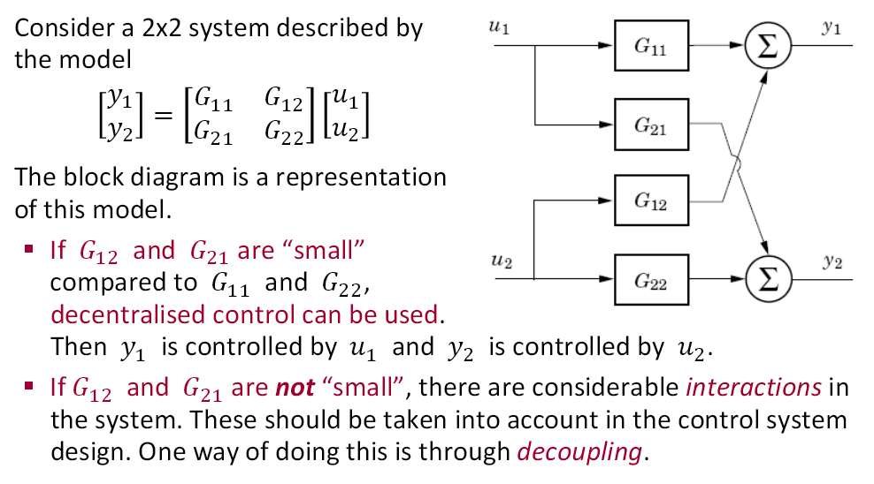
Decoupling

Slide 3
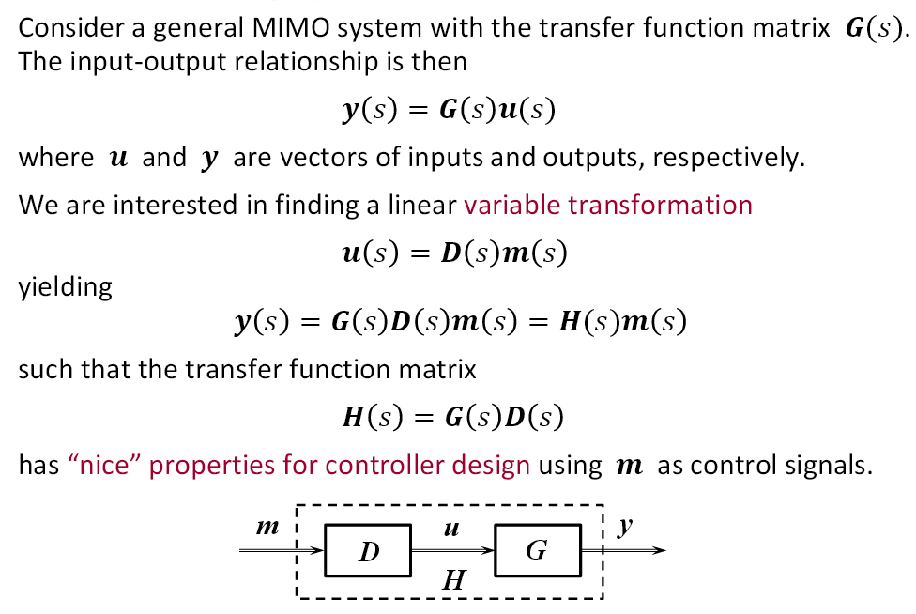
Design principle

Slide 4
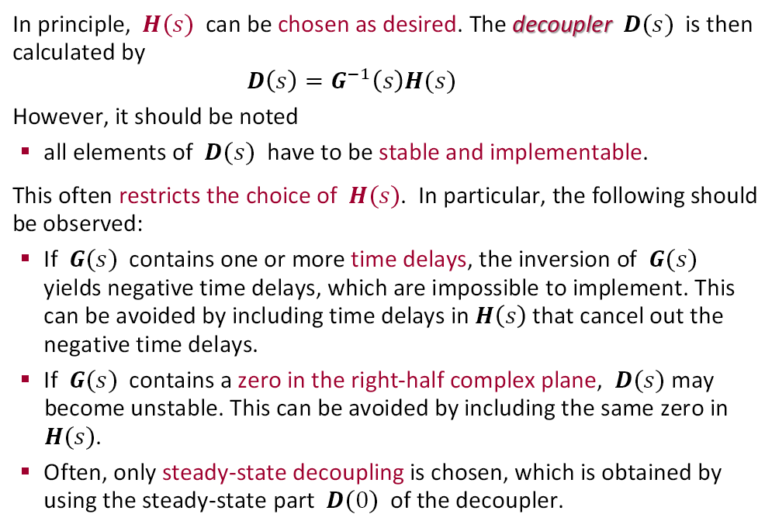
Design principle

Slide 5
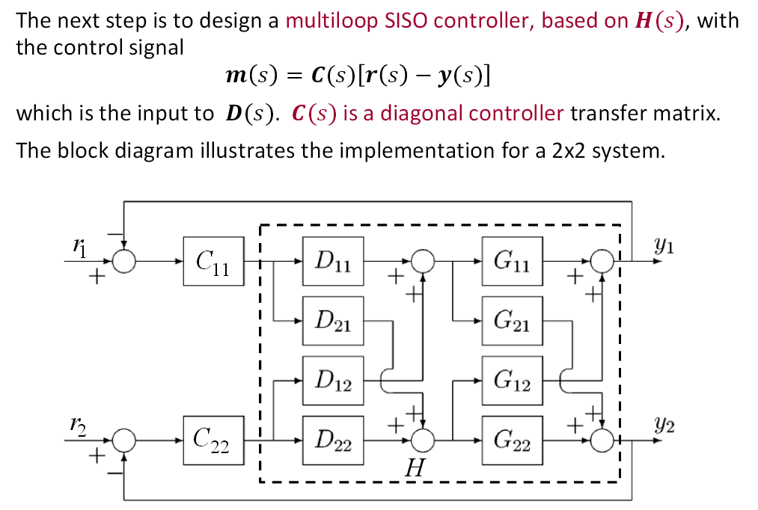
Design principle

Slide 6
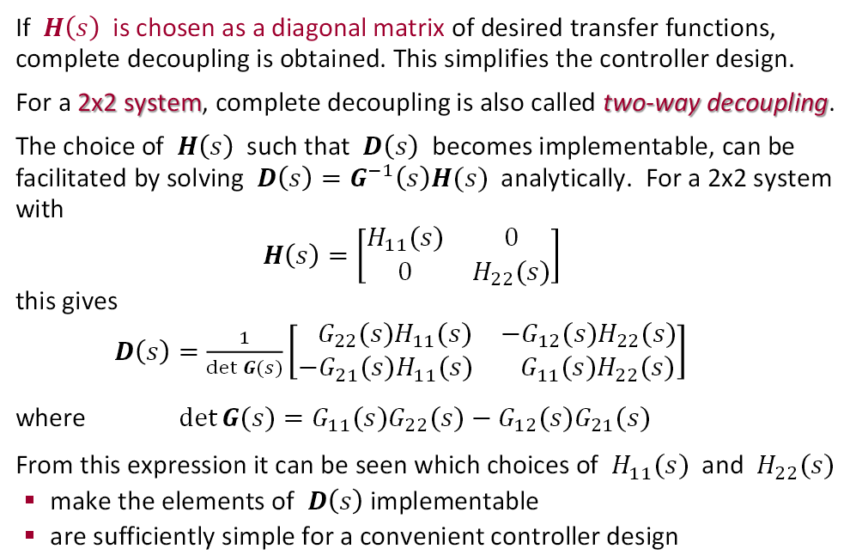
Complete decoupling

Slide 7
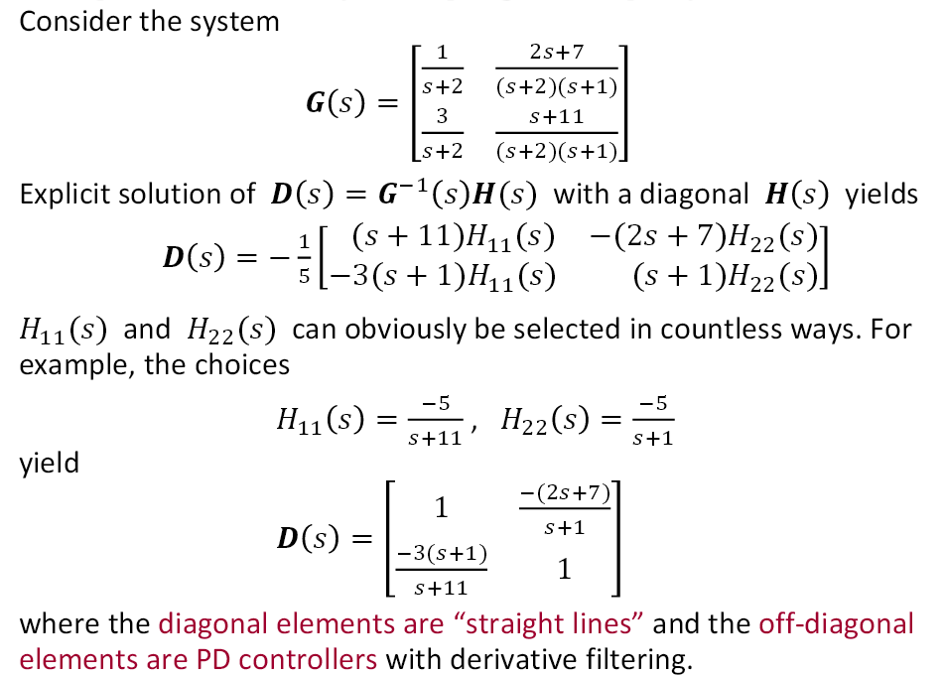
Example

Slide 8
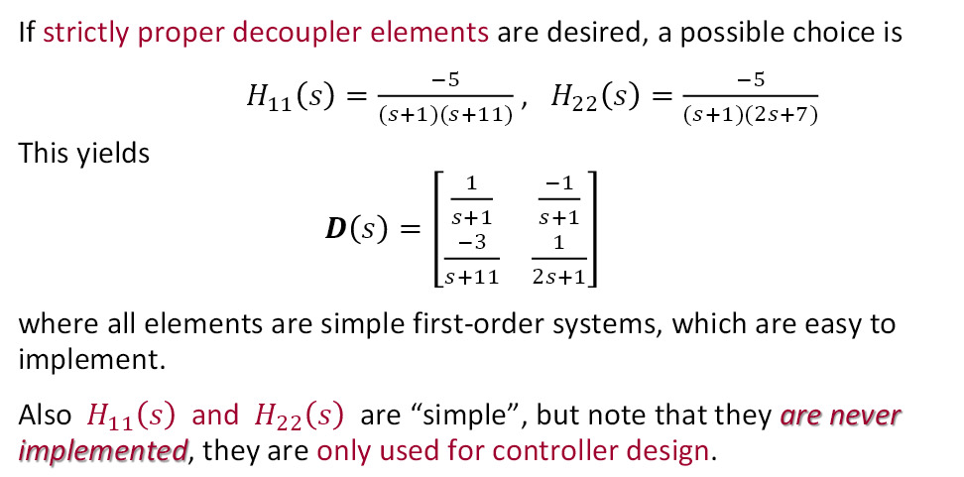
Example

Slide 9
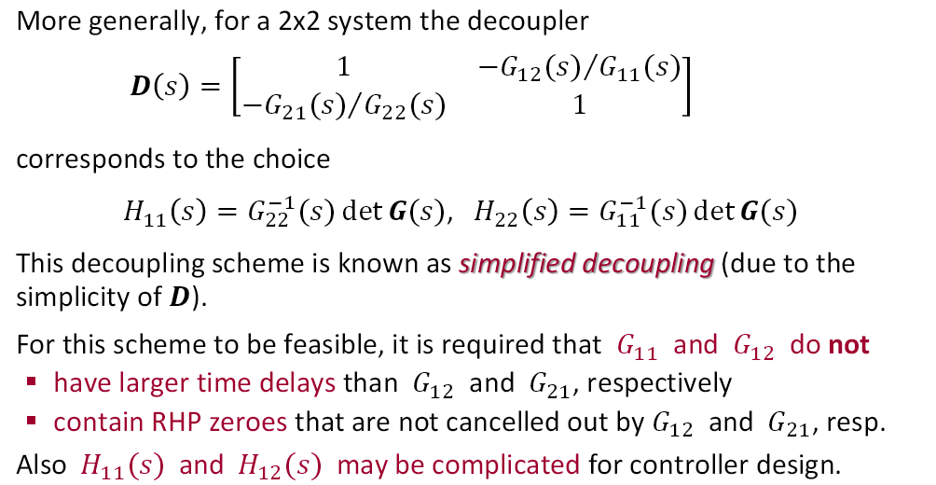
Standard choices of decoupler elements

Slide 10
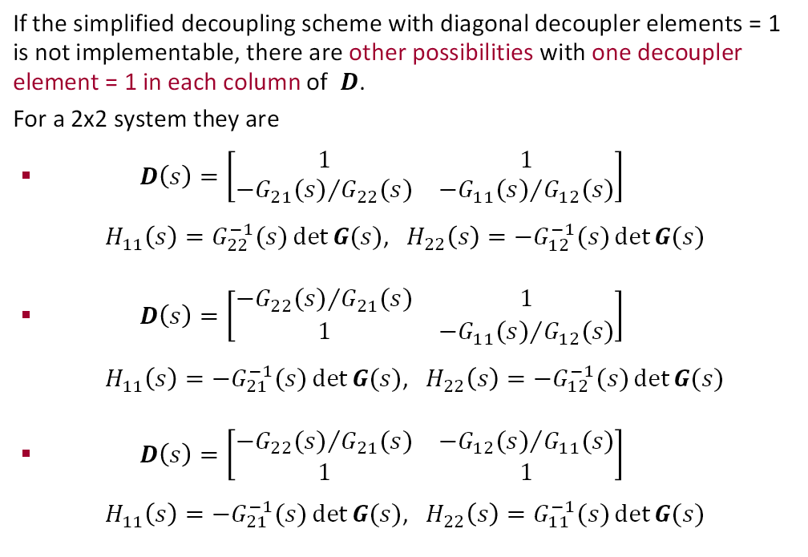
Standard choices of decoupler elements

Slide 11
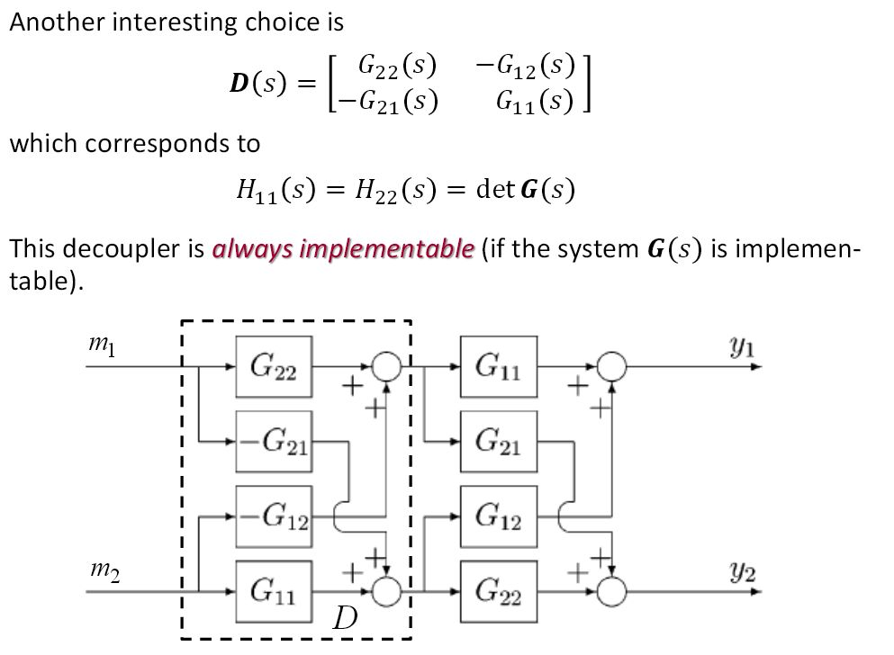
Standard choices of decoupler elements

Slide 12
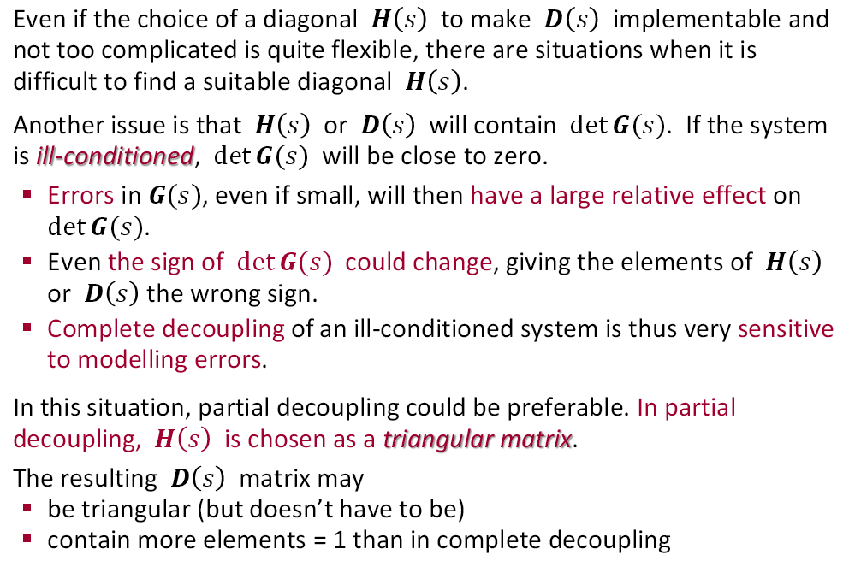
Partial decoupling

Slide 13
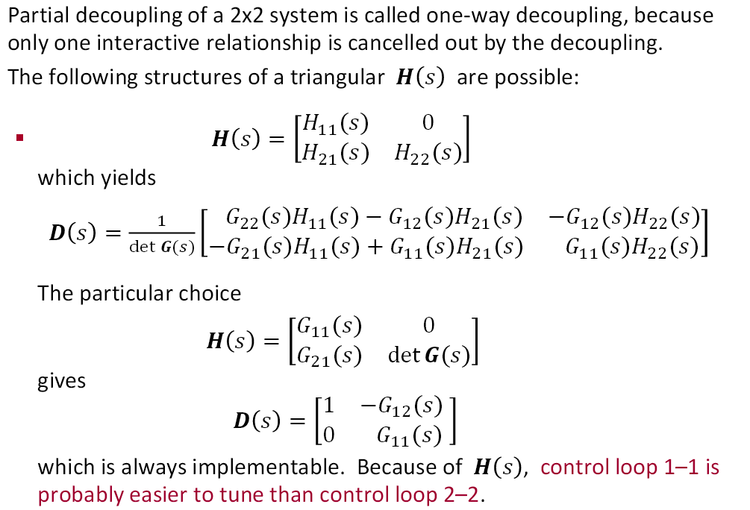
Partial decoupling

Slide 14
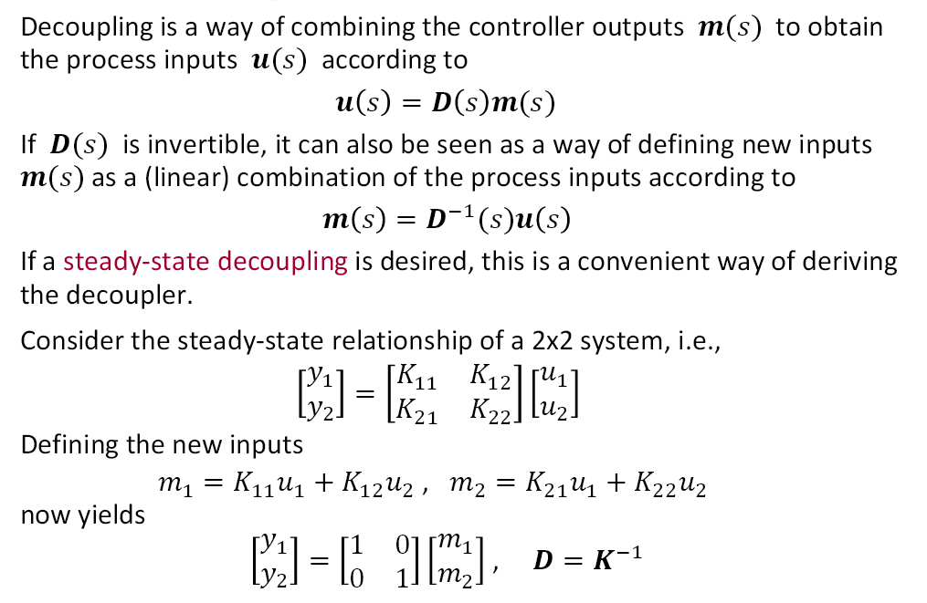
Decoupling by linear combination of inputs

Slide 15
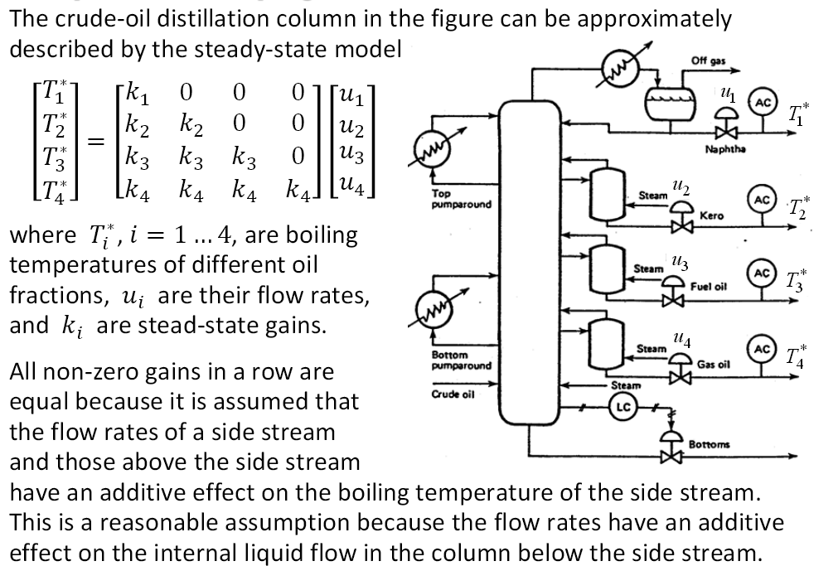
Example

Slide 16
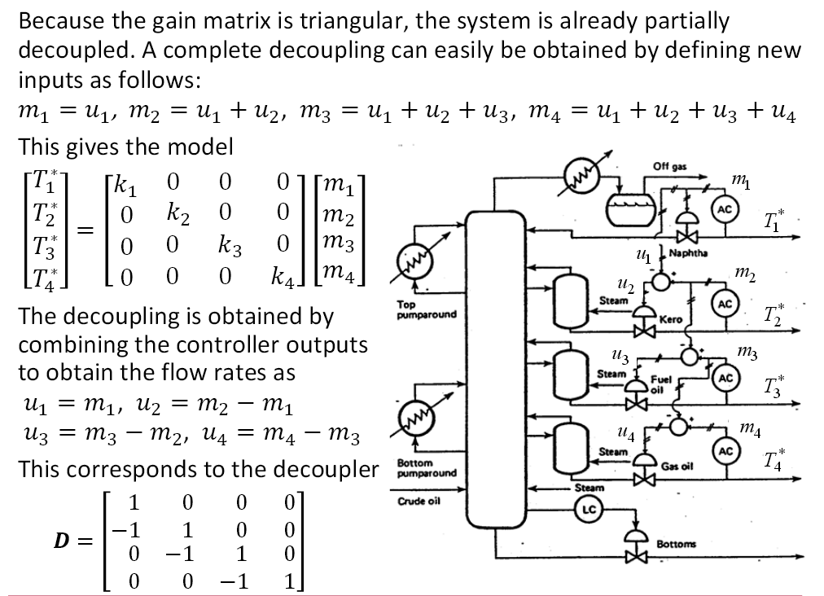
Example

